Slide 1
Title: Movie Recommendation System
Presenter:
Date:

Slide 2
Data Preparation
1. Data Loading:
Import user data, movie data, and rating data from corresponding files (e.g., 'users.dat', 'movies.dat', 'ratings.dat’).
2. Merge Data:
Combine user data with rating data and movie data using shared columns ('UserID' and 'MovieID’).
3. Column Structure: UserID, Gender, Age, Occupation, MovieID, Title, Rating, Fantasy, Musical, Thriller ...

Slide 3
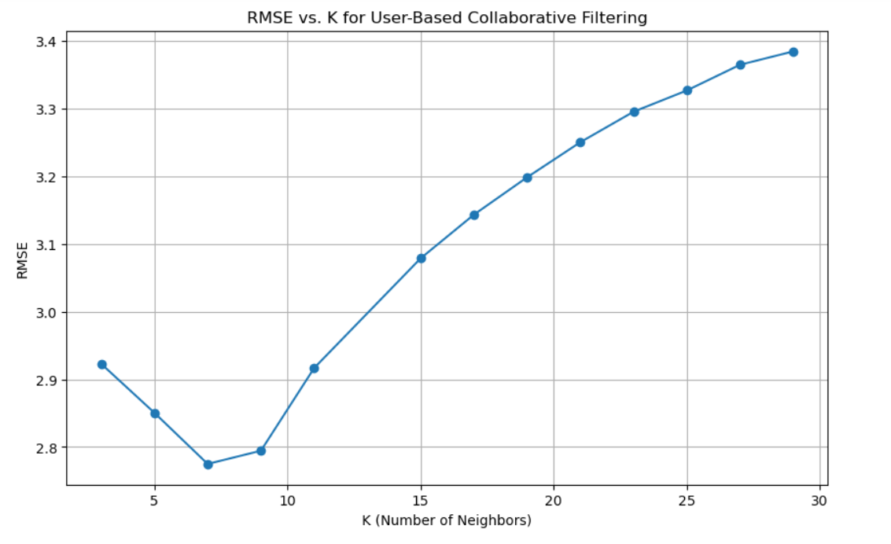
Task 1 : User-based Collaborative Filtering
Best K Value: 7
RMSE Score: 2.77493

Slide 4
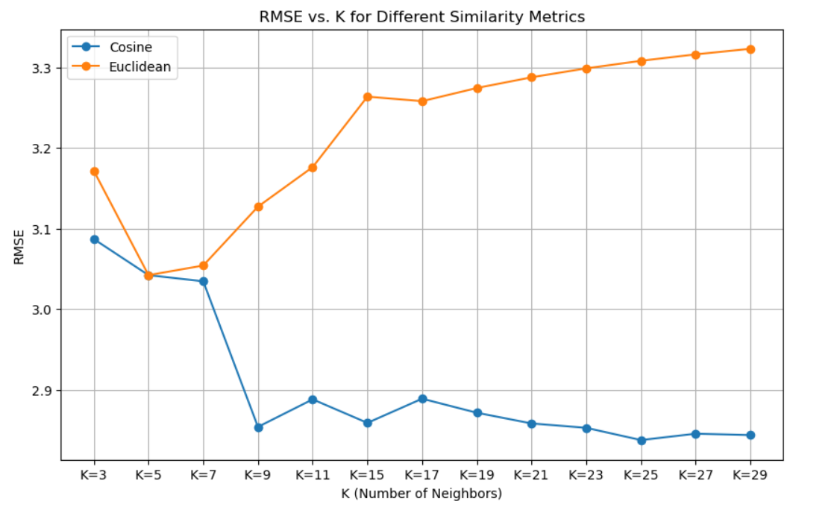
Task 2: Item-based Collaborative Filtering
Best Combination: K = 25
Similarity Metric: Cosine
RMSE: 2.8376

Slide 5
Literature Review (1/2)
Title: Autoencoder in Recommendation Systems
Background: Autoencoders serve as unsupervised deep learning methods widely applied in recommendation systems.
Model Structure: Typical autoencoder architecture includes input, hidden, and output layers, forming an encoder and decoder.
Code Representation: The code represents the compressed input, facilitating data reconstruction.
Applications of Autoencoders
Data Dimensionality Reduction: Autoencoders excel in reducing the dimensionality of data.
Noise Cleaning: Capable of cleaning noisy data for improved model performance.
Feature Extraction: Extracts meaningful features from input data.
Data Reconstruction: Reconstructs data from the compressed, encoded representation.

Slide 6
Literature Review (2/2)
Insights from Literature
Autoencoder Efficiency in Recommendation Tasks: Literature emphasizes the proficiency of autoencoders in handling recommendation tasks.
Challenges in Parameter Selection: Researchers face challenges in selecting optimal parameters such as activation functions, optimizers, and dropout rates.
Parameter Considerations: Different studies employ varied parameter sets, often requiring a "trial and error" approach.
Activation Function Choice: Tanh for encoder and latent space, Linear for the output layer, supported by experiments demonstrating superior results.
Optimizer and Loss Function: Commonly, the Adam optimizer with a learning rate of 0.0001 and MSE as the loss function.
Insights Gained
Autoencoders, especially with Tanh activation for encoder layers, show promise in capturing intricate patterns in recommendation systems.
Parameter selection is critical, requiring a careful balance between experimentation and established practices.
The dropout layer contributes to preventing overfitting, enhancing the generalization of the model.

Slide 7
Task 3 : Option1RecSys : Solution from Publications
Description of the Chosen Solution: Implemented a collaborative filtering recommendation system using an autoencoder neural network.
Implementation Details:
The neural network architecture includes an input layer, three dense layers with ReLU activation functions, and a final dense layer with a sigmoid activation function.
Custom RMSE loss function used for training.
The model was trained on movie rating data, and recommendations were generated based on predicted ratings.

Slide 8
Algorithm Details for Option 1 RecSys
Title: Autoencoder-Based Recommendation Algorithm
Algorithm Explanation:
1. Architecture Overview: Input, hidden, and output layers form a neural network for encoding and decoding.
2. Custom RMSE Loss Function: Utilized for training, focusing on minimizing the prediction error.
3. Model Compilation: Adam optimizer chosen for its speed and memory efficiency.
4. Training Process: Autoencoder trained on movie rating data, adjusting weights to improve predictions.
Recommendation Generation and Evaluation:
1. User-Specific Predictions: Predicted ratings generated for selected users using the trained autoencoder.
2. Top-30 Recommendations: Sorting movies by predicted ratings and recommending the top 30 to each user.
3. Performance Metrics: Average Precision (AP) and Normalized Discounted Cumulative Gain (NDCG) calculated to evaluate recommendation quality.
4. Average Metrics: Overall performance assessed through the average AP and NDCG scores.

Slide 9
Key Results and Visualizations
Content:
Average AP: 1.000000000000000
Average NDCG: 0.9999999999999998
Epoch 10 RMSE Score: 6.7753e-04
Visualization:
Visual representation of the top-30 movie recommendations for a sample user (including titles and predicted ratings)
Bar chart showcasing the performance metrics (AP and NDCG) for each user
Line chart illustrating the training progress with epochs (x-axis) and RMSE values (y-axis)

Slide 10
References:
1. Recommendation System Using Autoencoders by Diana Ferreira, Sofia Silva, António Abelha, José Machado University of Minho. 10 August 2020
2. Zaslavsky, A.; Perera, C.; Georgakopoulos, D. Sensing as a service and big data. arXiv , 2013
3. Zhang, G.; Liu, Y.; Jin, X. A survey of autoencoder-based recommender systems. Front. Comput. Sci. 2020, 14, 430–450.

